Slide 1
Clinical examination in DNS
Dr.D.Anand Karthikeyan MS,
Associate Professor,
ENT Department

Slide 2
Review of History
Nasal block
anosmia/hyposmia
Disfigurement
Pain nose
Epistaxis
Nasal discharge
Side/laterality
Onset
Duration
Progression
Aggravating/ relieving factors
Associated symptoms

Slide 3
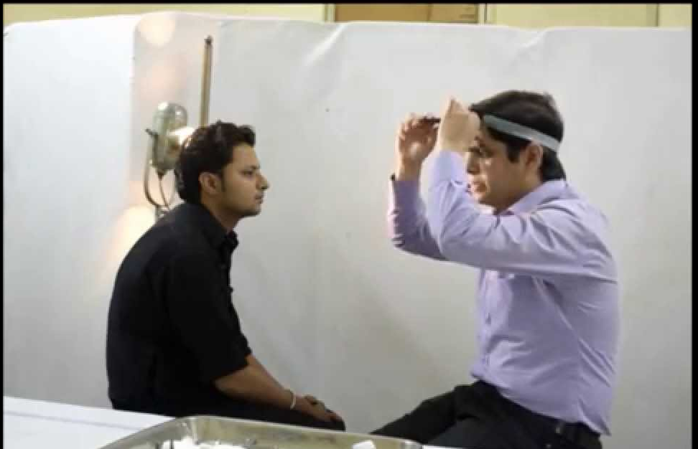
Positioning for nasal examination

Slide 4
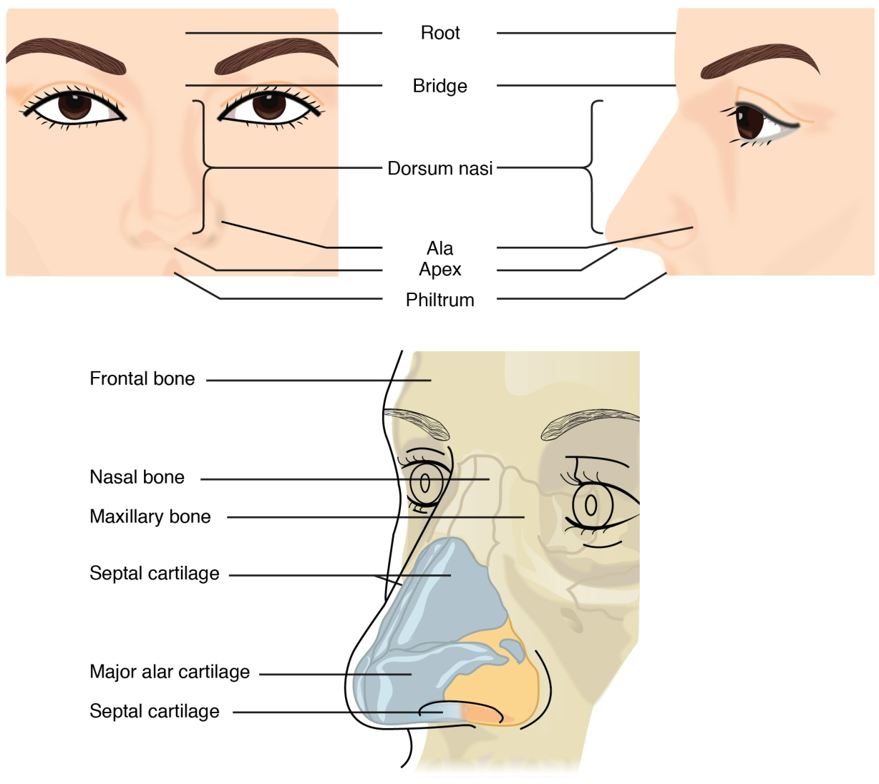
External nasal examination

Slide 5
Abnormalities of external nose
Frontal view
Lateral view
  Disfigurements:
    Dorsum
    Tip
    Supratip
Swellings
Sinus/ fistula
Discolouration of skin
Edema of skin

Slide 6
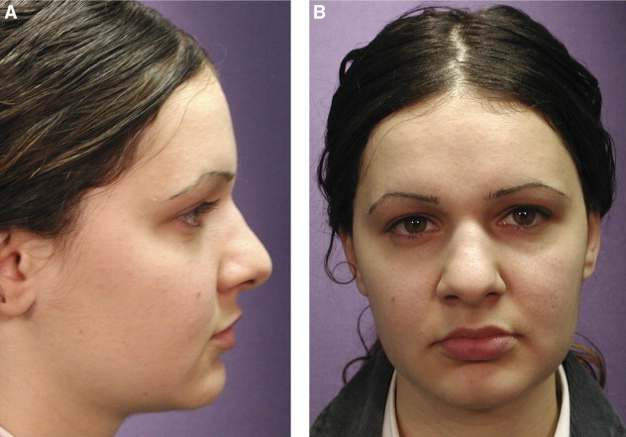

Slide 7
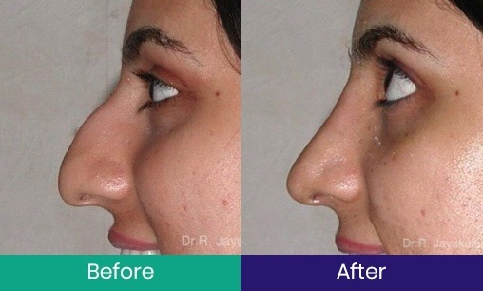

Slide 8
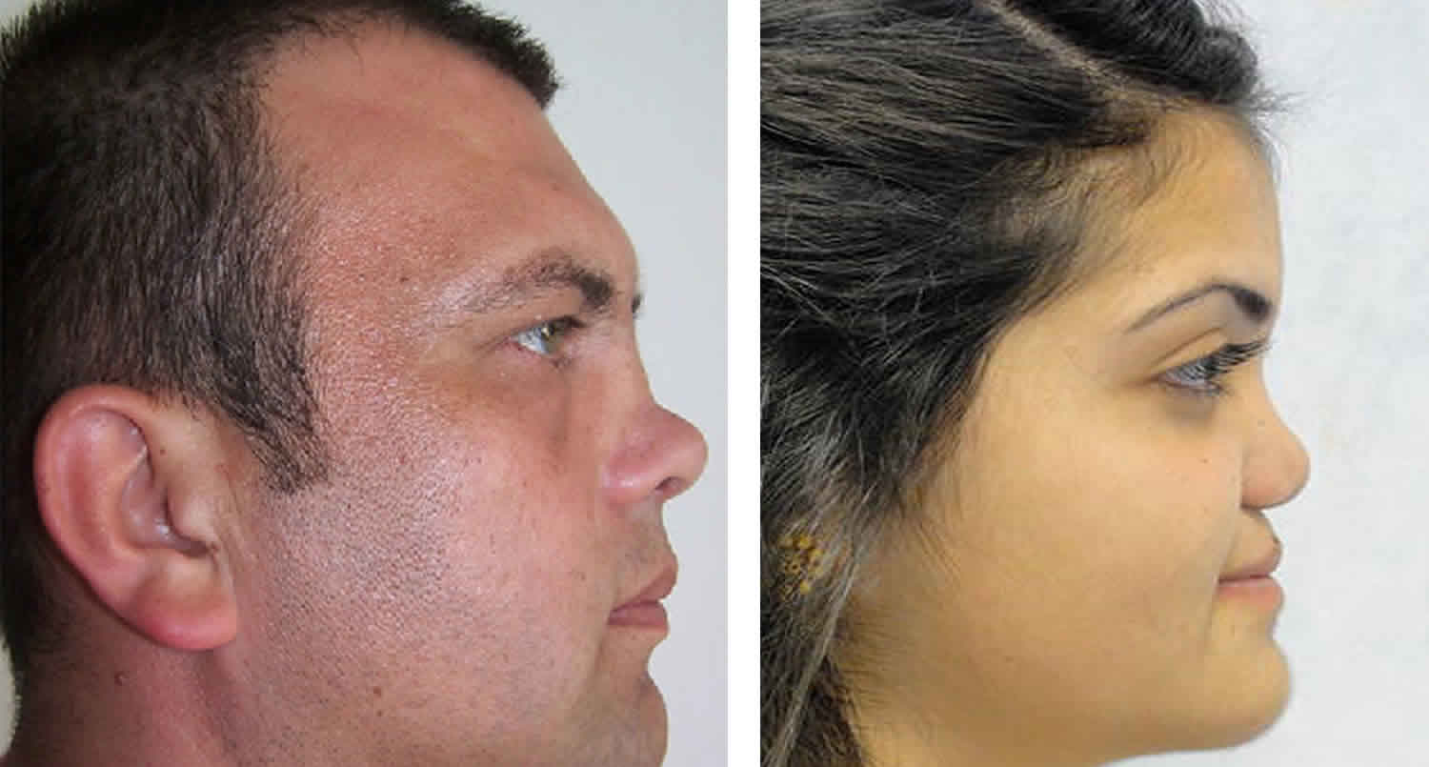

Slide 9
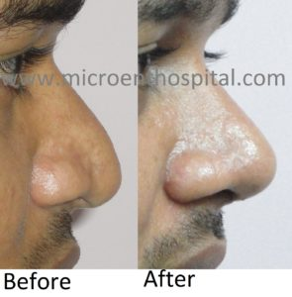

Slide 10
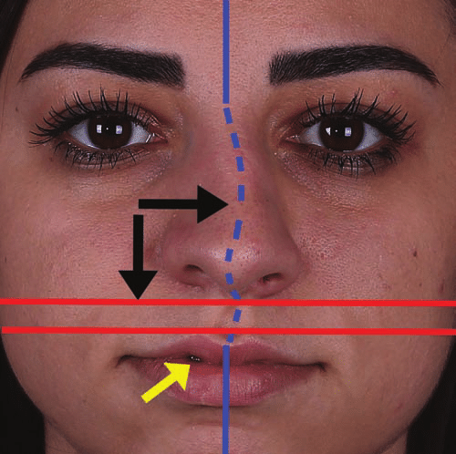

Slide 11
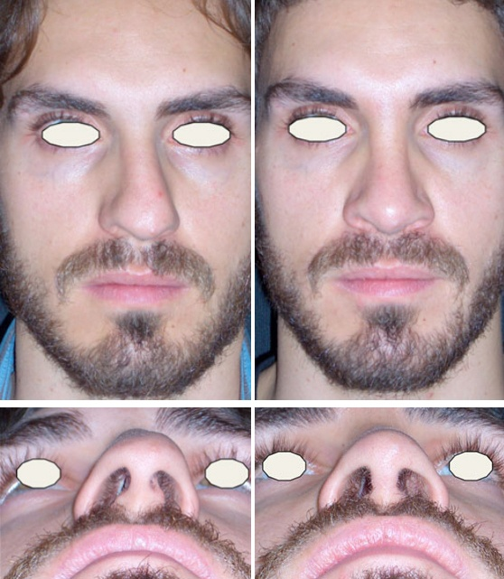

Slide 12
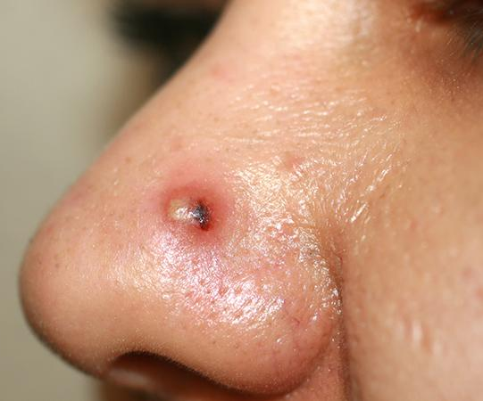
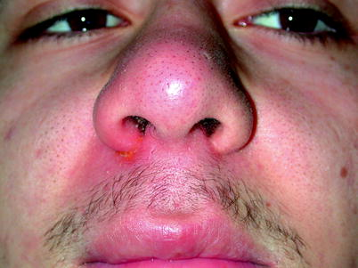

Slide 13
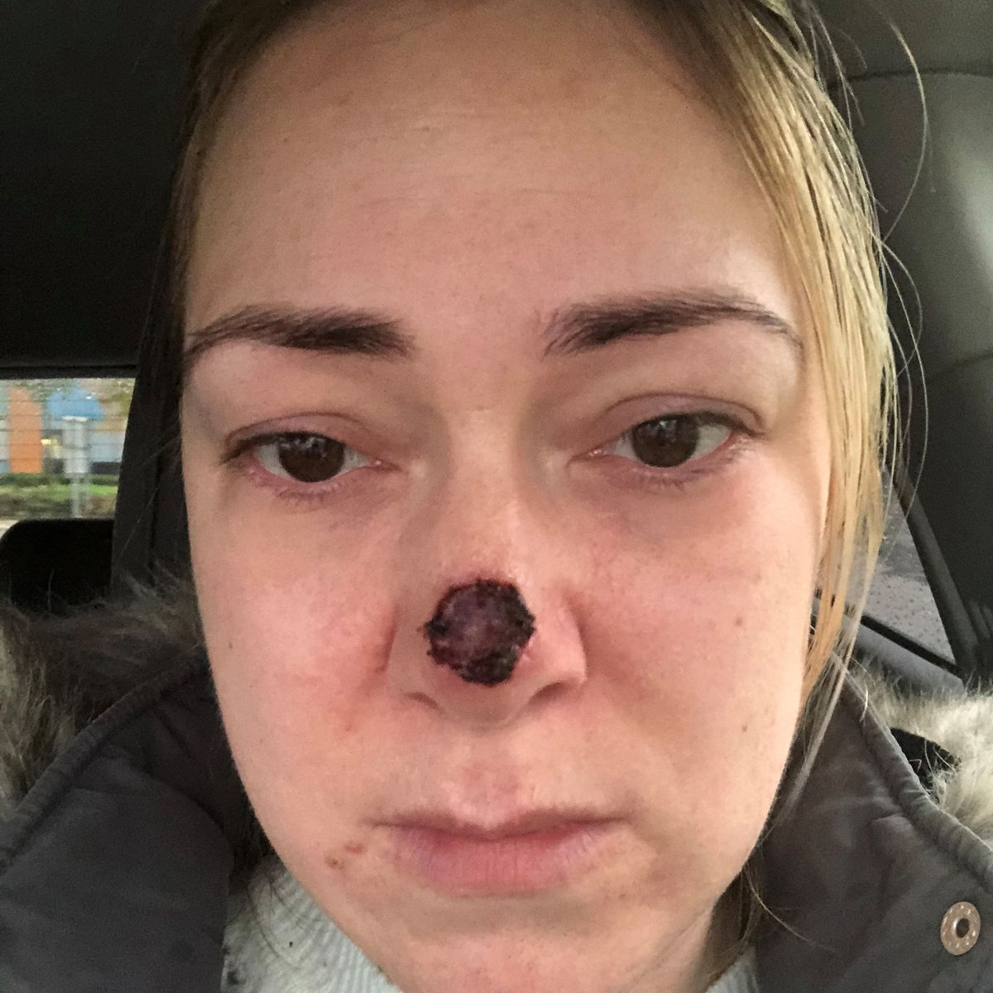
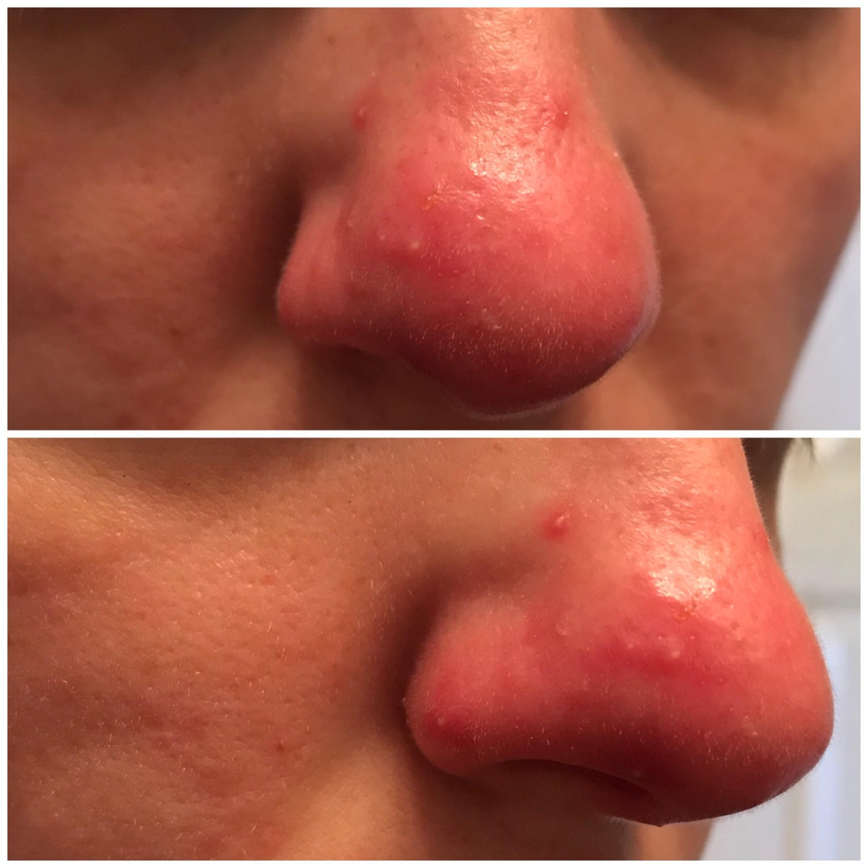

Slide 14
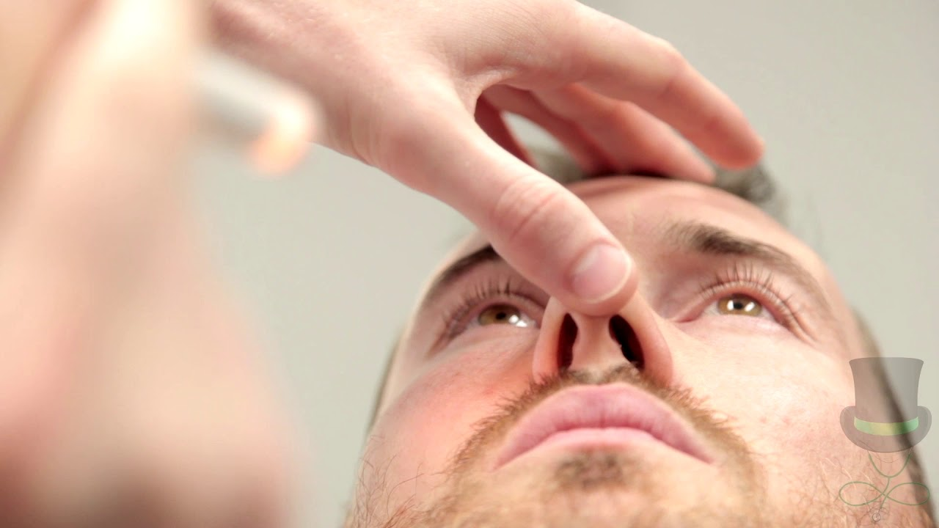
Nasal vestibule examination

Slide 15
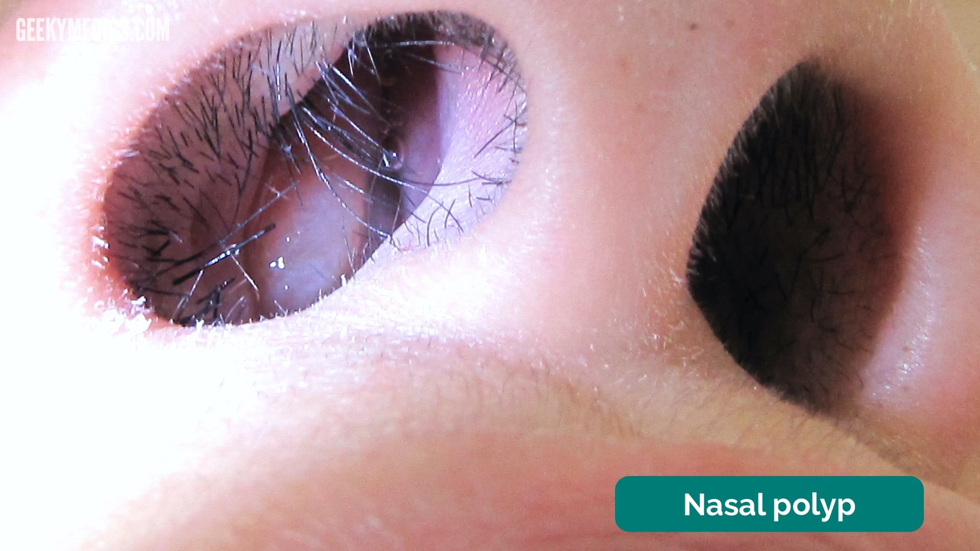

Slide 16
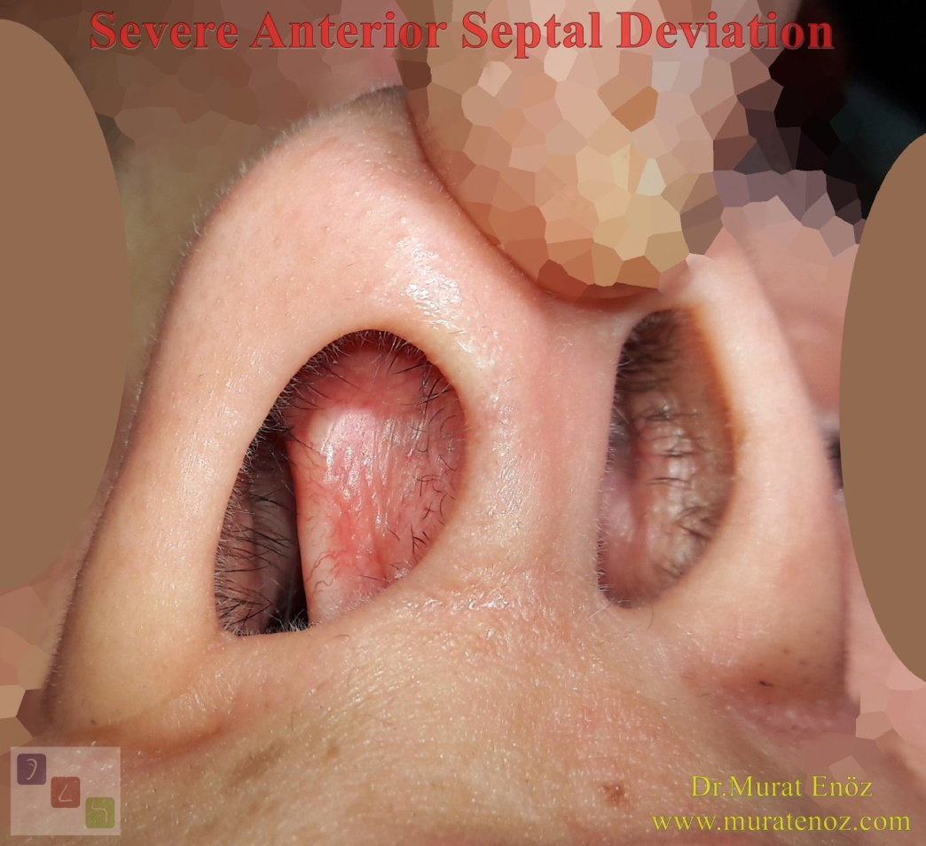
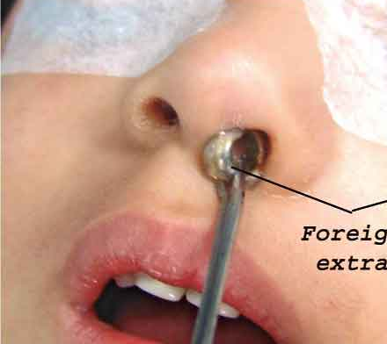
Abnormalities in nasal vestibule

Slide 17
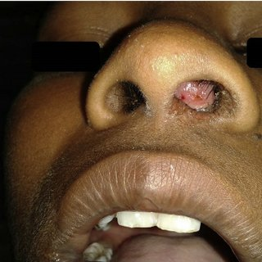

Slide 18
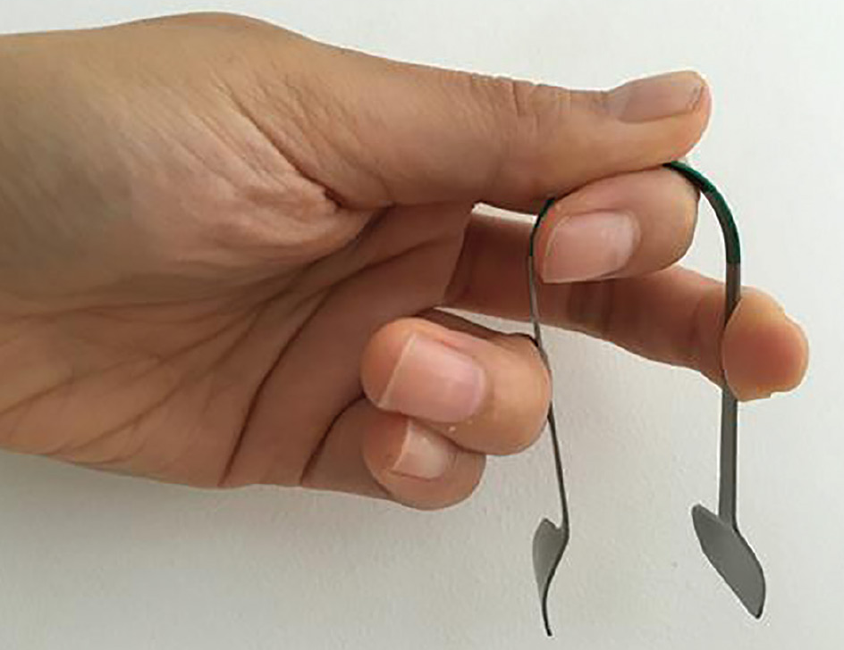
Anterior rhinoscopy - instruments

Slide 19
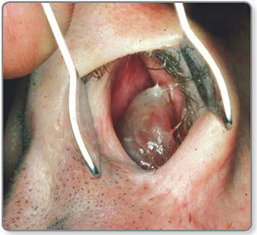

Slide 20
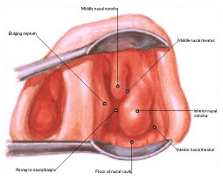
Structures visible in anterior rhinoscopy
Roof
Floor
Lateral nasal wall
  Turbinates
  Hypertrophy
  atrophy
Septum
Contents/abnormalities
  discharge
  polyp
  foreign body
  crusts
  blood/clots
  mass

Slide 22
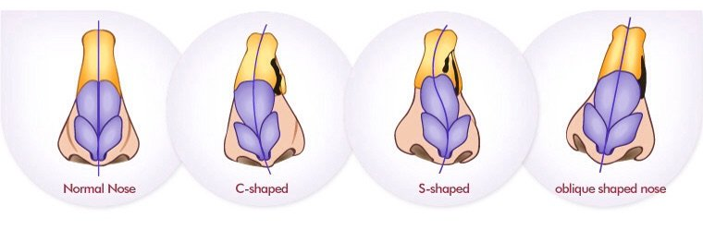
Nomenclature of DNS

Slide 23
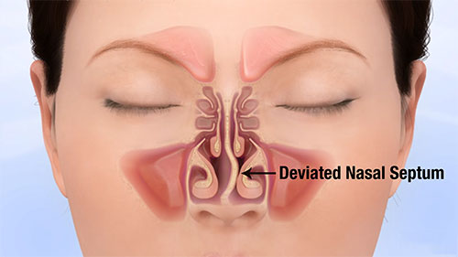

Slide 24
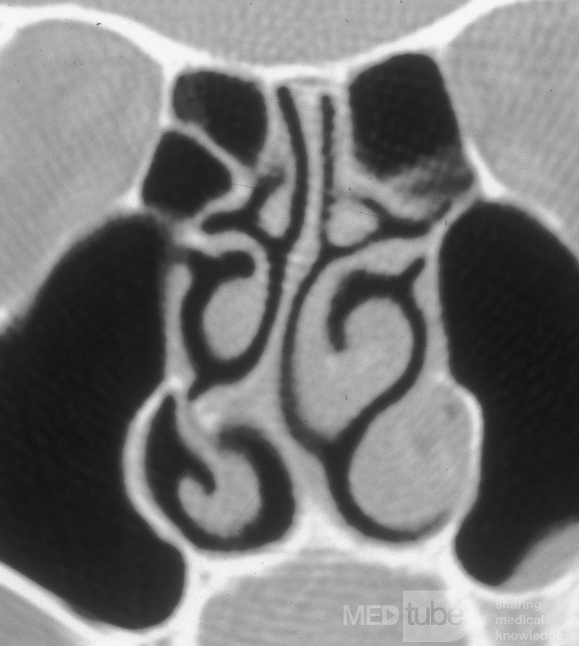
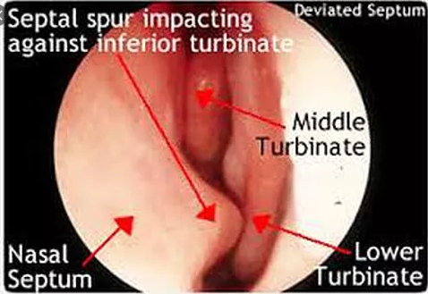
Septal spur

Slide 25
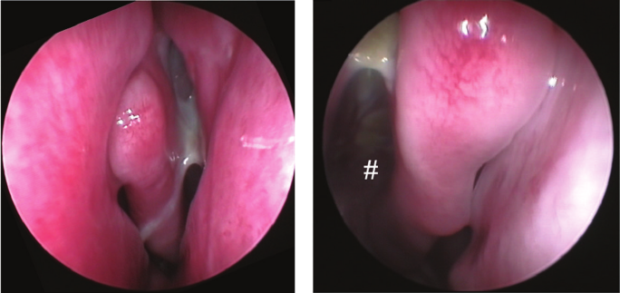
Abnormalities in anterior rhinoscopy

Slide 26
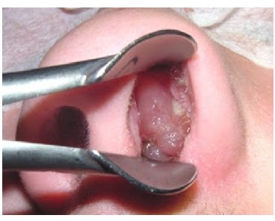
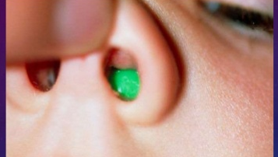
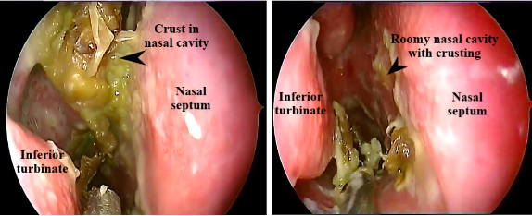
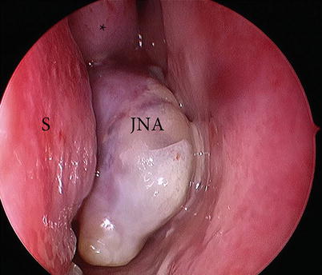

Slide 27
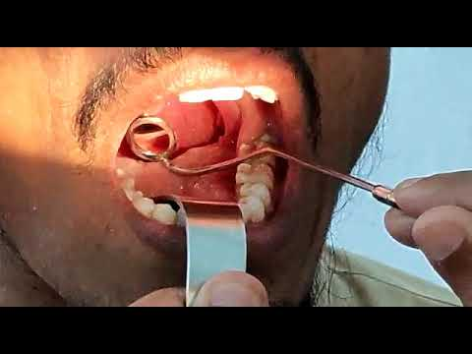
Posterior rhinoscopy

Slide 28
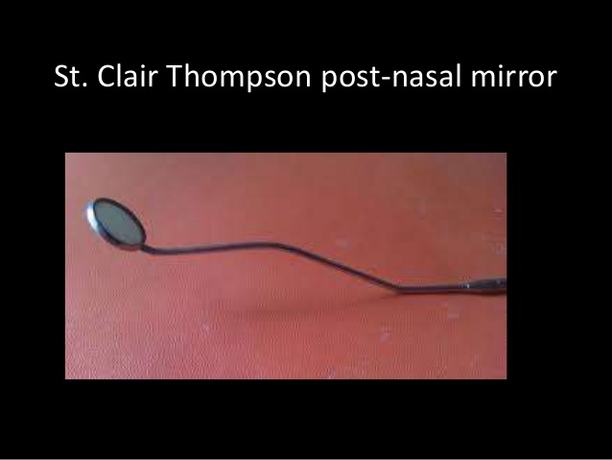
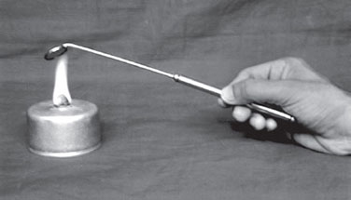

Slide 29
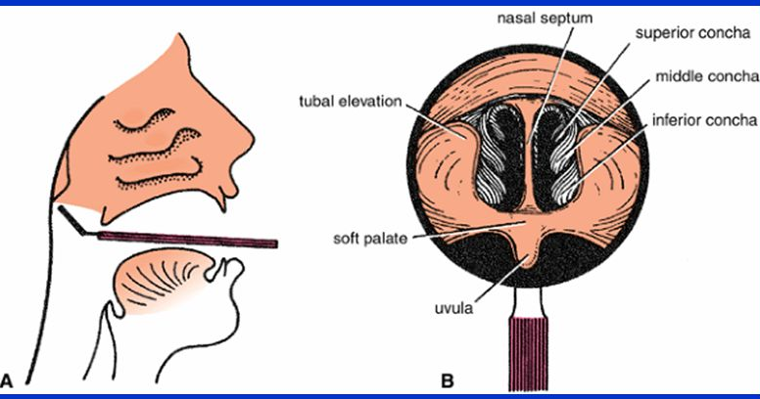
Structures seen in posterior rhinoscopy

Slide 30
Nasal airway patency tests
  Cold spatula test.
  Cotton wool test.
  Cottle`s test

Slide 31
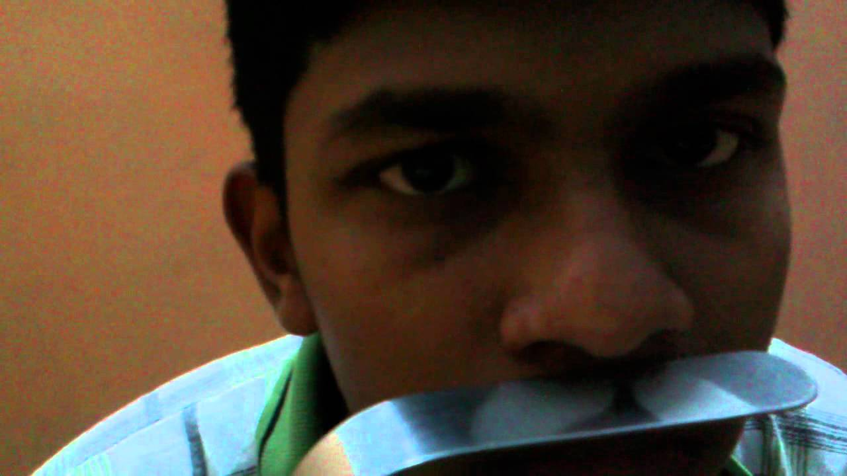
Cold spatula test
Take a lack`s tongue depressor and keep in front of the nasal aperture over the upper lip and ask the patient to breath normally and observe for condensation of air over the tongue depressor. Reduced fogging or no fogging indicates nasal obstruction.

Slide 32
Cotton wool test
Take a whisp of cotton and keep in front of nasal aperture on each side and observe the movement of cotton. Reduced or no movement indicates nasal obstruction.

Slide 33
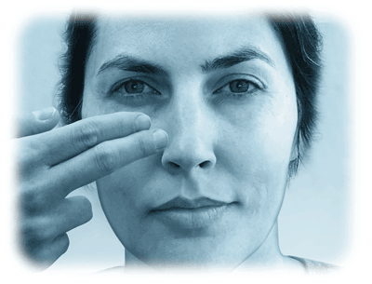
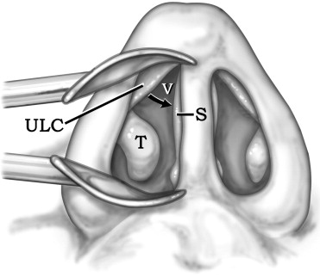
Cottle`s test
Keep the hand over cheek of the patient and push it laterally and if the patient is relieved of nasal obstruction on that side, it indicates that obstruction is in the nasal valve area.

Slide 34
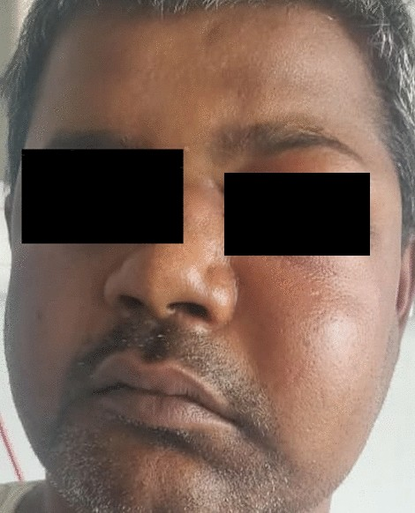
Paranasal sinuses examination
Inspection
palpation/tenderness
transillumination

Slide 35
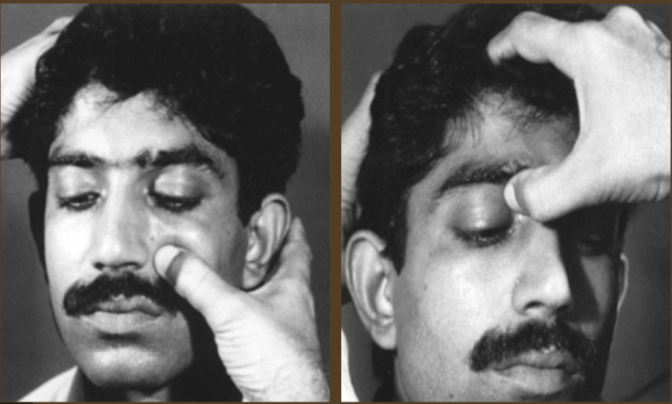
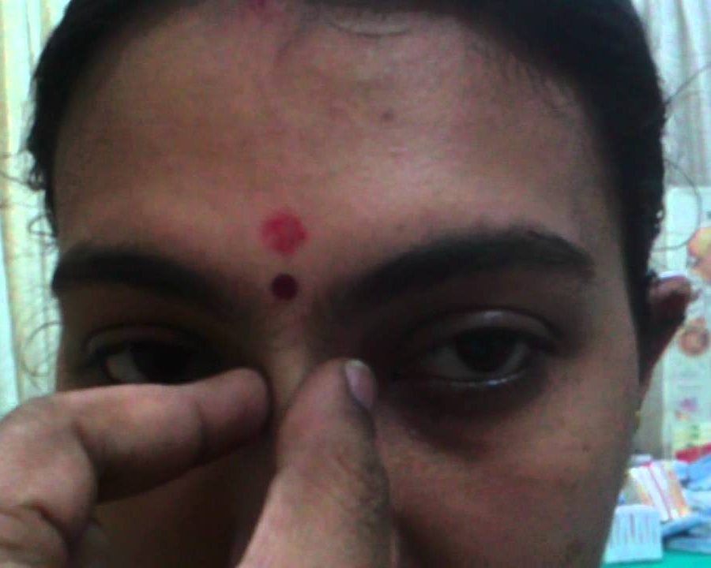
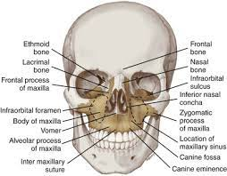

Slide 36
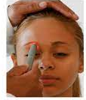
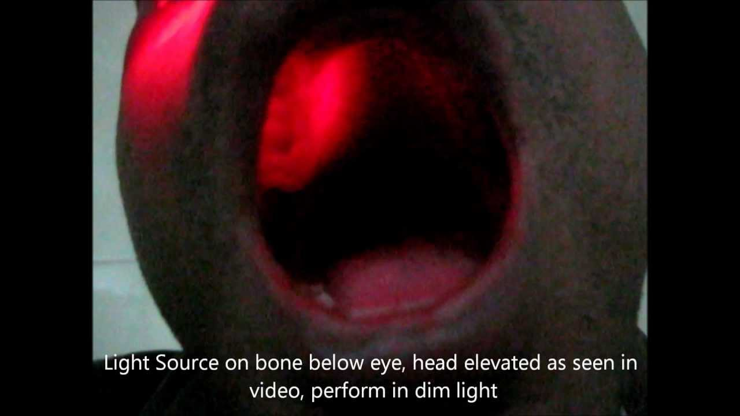

Slide 37
Diagnosis presentation
Deviated nasal septum to the …………………{right/left}, …………(type) of deviation; anterior / posterior deviation.
septal spur (if present only).

Slide 38
management
Investigations:
Xray Nose & Paranasal sinuses water’s view
CT PNS coronal & axial views
Other routine preoperative investigations
Treatment:
Surgical correction: septoplasty/SMR
SMR: SubMucous Resection of nasal septum
Difference of choice?
Steps
Complications of surgery

Slide 39
SUB MUCOSAL RESECTION OF SEPTUM for posterior deviations
SEPTOPLASTY for anterior deviations

Slide 40
Indications for SMR
DNS causing symptoms of nasal obstruction and recurrent headaches.
DNS. Causing nasal obstruction resulting in recurrent sinusitis and otitis media.
Recurrent epistaxis from septal spur.
Source of graft material in rhinoplasty and tympanoplasty.
To obtain surgical access in:
    Hyphophysectomy
    Vidian neurectomy.

Slide 41
Indications for septoplasty
Anterior deviation of nasal septum.
As a part of septorhinoplasty for cosmetic reasons.
Recurrent epistaxis due to septal spur

Slide 42
Contra indications for SMR
- Patients below 17 years of age (Septoplasty should be done)
- Bleeding diathesis.
- Acute episodes of respiratory infections

Slide 43
Complications of SMR
1. Septal haematoma.
2. Septal abscess.
3. Septal perforation.
4. Supra tip saddling.
5. Retraction of columella.
6. Flapping of nasal septum.
7. Toxic shock syndrome-rarely.

Slide 45
Indications of SMR, when there is no deviation
To obtain surgical access in:
1. Hypophysectomy.
2. Vidian neurectomy.
3. Septal cartilage graft

Slide 46
SMR SEPTOPLASTY
Done for posterior deviation
Killian`s incision
Mucoperichondrium elevated on both sides
cartilage and bone removed
Complications common
Revision surgery difficult
Redeviation chances less
Done for anterior deviation
Freer`s hemitransfixation
Mucoperichondrium elevated on one or both sides
Minimal cartilage removed
Complications rare
Revision surgery possible
Redeviation chances +

